Slide 1

WellNest: A Health Information System
A comprehensive health information system for managing clients and health programs

Slide 2
Introduction
Overview
The system simulates a health information management system that allows doctors to create health programs, register clients and enroll them in programs. It is designed for easy management and access of client health data
Technologies Used
Frameworks – Django, Django Rest Framework
Database – SQLite
Frontend – HTML,CSS, JavaScript, Bootstrap

Slide 3
Key Features
Doctors should register and login to the system to be able to access the following features:
Create new health programs for diseases like TB and Malaria
Register new clients into the system
Enroll clients into one or more health programs
Search for registered clients
Expose client profiles via API
View the number of clients enrolled in each program

Slide 4
Project Approach
API-First Development
Prioritized building backend APIs for exposing client profile data which enables easy integration with external systems using Django REST Framework
Modular and Scalable Design
Separate models for doctors, clients and health programs with many to many relationships for flexible client enrollment.
Clean and Structured Code
MVC architecture (Models, Views, Templates) with Django and an organized project structure with reusability and maintainability in mind

Slide 5
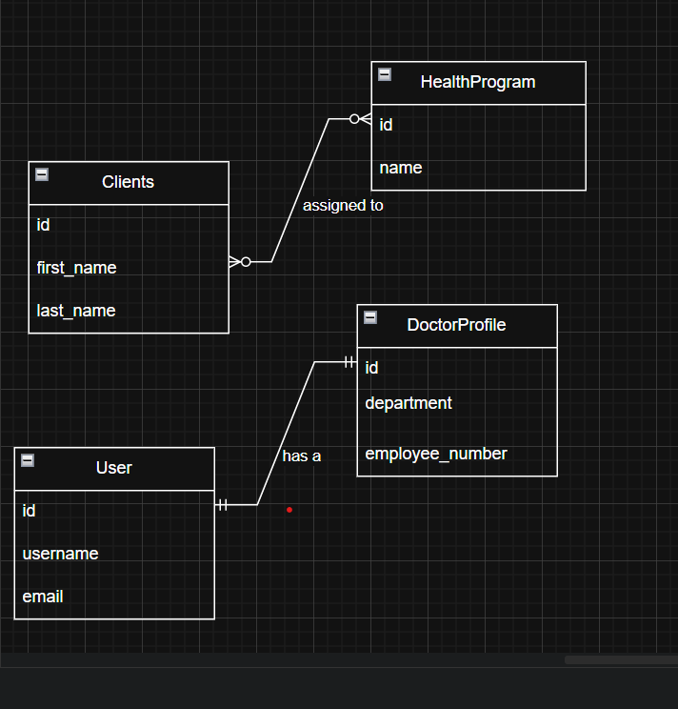
DESIGN
The design is focused providing maximum functionality for the users
Client: Stores client information including personal details and enrolled health programs
HealthProgram : Represents the different health programs available
DoctorProfile: Extends user information wit department and employee number

Slide 6
SOLUTION
The WellNest Health Information Management System is designed to enhance patient care through a seamless platform that integrates both clinical and administrative functionalities. Built with a Django backend and employing an API-first approach, WellNest allows healthcare professionals to create and manage health programs, register clients, and monitor their progress through a range of features.
Key functionalities include:
Program Creation and Enrollment: Doctors can create personalized health programs and enroll clients in those programs, offering tailored support.
Client Registration and Profile Management: Clients are registered within the system, where they can manage their personal health information, view enrolled programs, and track their progress.
API Integration: An API-first approach is incorporated to allow easy data exchange with external systems, ensuring extensibility and integration with other health systems.
Client Profile Access: Doctors can access and review detailed client profiles, including enrolled programs, progress, and health-related data, ensuring informed decision-making.
Data Security: The system emphasizes high standards of data security, ensuring the confidentiality of sensitive health data.
User Interface: An HTML dashboard provides healthcare professionals with an intuitive interface to manage clients and health programs while maintaining access to the Django super admin interface for system administration.

